Slide 1

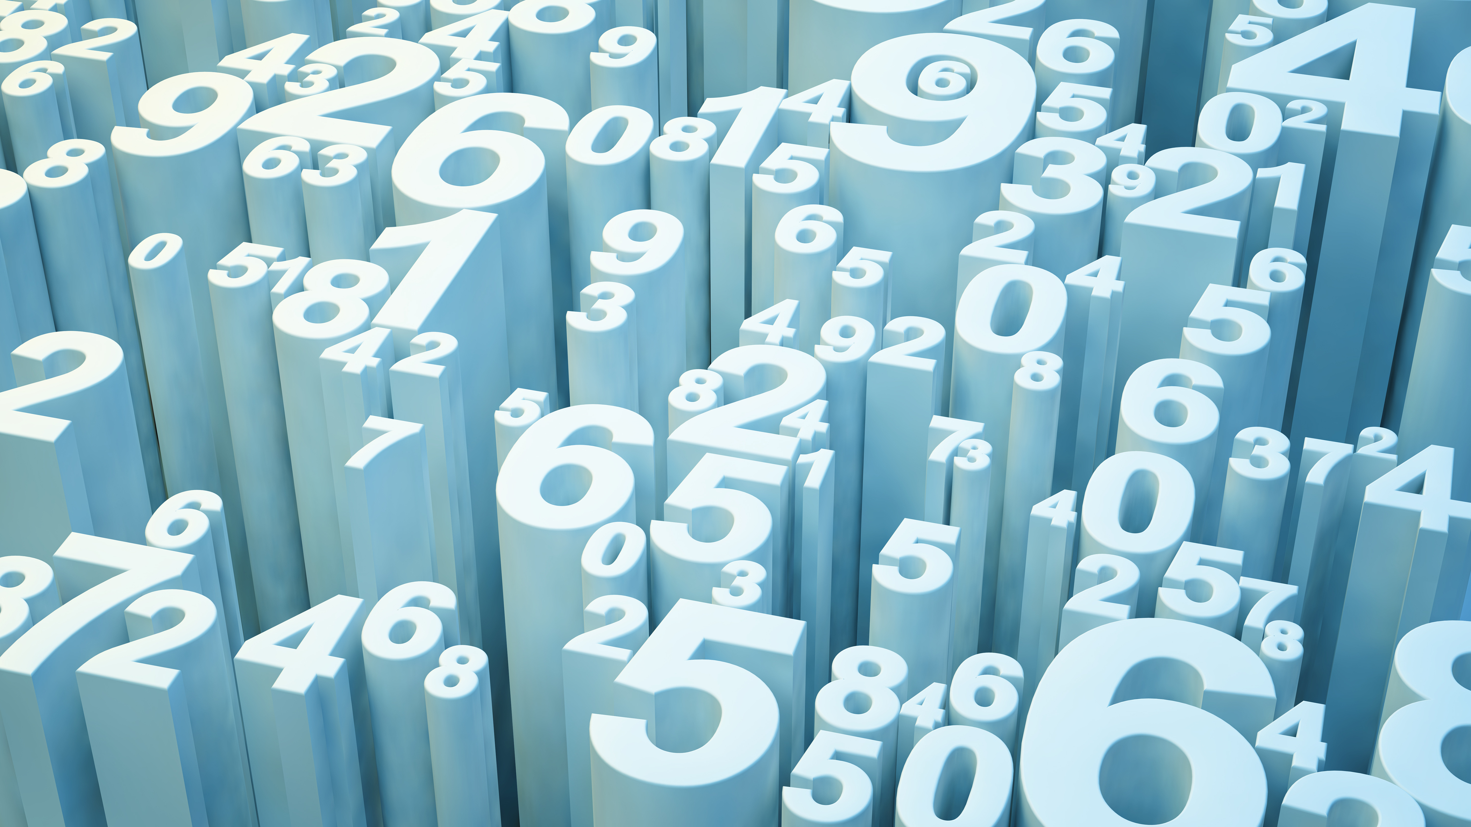
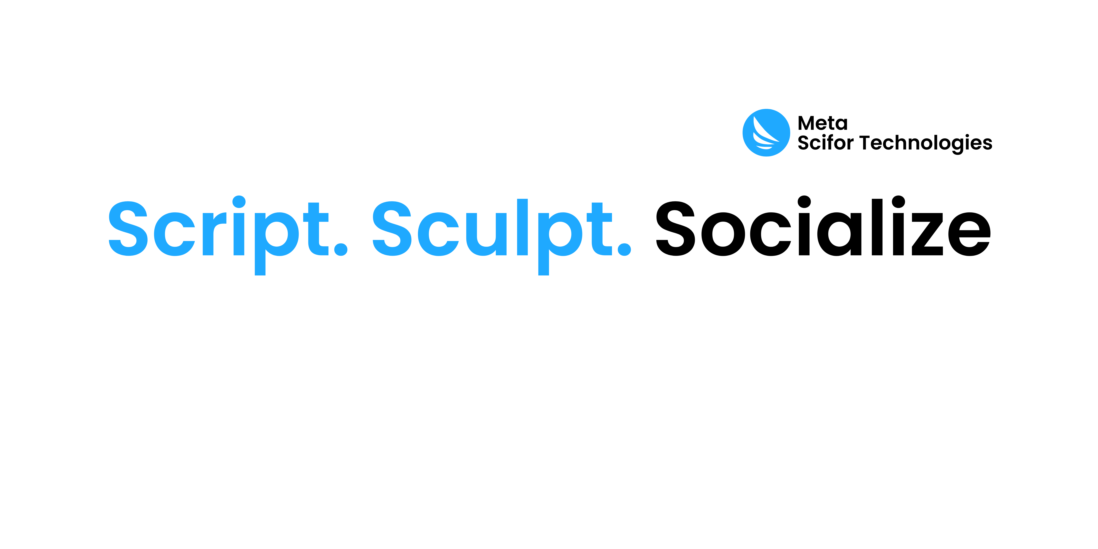

“Project-Title”
“Review_Scrapper_Project (Flipkart)”
Presented by- Vijay Gurung
Intern ID : MST03-0070
Guided by – “Urooj khan”
( AI Engineer |Data Scientist )

Slide 2

Agenda
Introduction Project
Overview Web Scraping Methodology
Technology Stack for project
Web Scraping and Flask Application
Implementing the Model
Deploying with AWS docker and azure
Results
Conclusion

Slide 3
Introduction
Automated Review Collection
Objective:
Goals:
Importance:
Accurate Data Retrieval
Consumer Insights
Data Extraction
Efficient Data Handling
Market Analysis
User-Friendly Interface
Interactive UI
Enhanced User Experience:
Technological Demonstration
Deployment:
Scalable Deployment
Data-Driven Decisions

Slide 4
Web_Scraping_Methodology
Approach
Tools:
Process:
1.Extract detailed product reviews from Flipkart to analyze customer feedback and ratings.
2.Fetching Product Pages
Use web scraping techniques to gather product information and reviews from Flipkart's search results and individual product pages.
1.BeautifulSoup:
For parsing and navigating the HTML content.
Converts HTML into a navigable tree structure for easy extraction of data.
2.Requests:
For sending HTTP requests to retrieve web page content.
Handles communication with Flipkart's web servers and retrieves the HTML pages.
1.Fetching the Page Content:
Send a request to Flipkart's search results page using the Requests library.
Retrieve the HTML content of the page.
2.Parsing the HTML
Use BeautifulSoup to parse the HTML content into a structured format.

Slide 5
Technology Stack for Project
Programming Languages:
- Python
Libraries/Frameworks:
1.Flask
2.BeautifulSoup
3. Requests
Deployment Platforms
1.AWS
2.Docker
3.Azure
Database:
databases like SQLite, MySQL, or MongoDB

Slide 6
Flask Application
Web Scraping
Code Overview
Fetching Page Content
Parsing HTML and Extracting Data
Data Extraction
Features
Search Interface
Displaying Reviews
Extraction Logic
Review Ratings
Comments
Prices
Code Overview
Handling Requests
Rendering Results

Slide 7
Data Cleaning
Sentiment Analysis
Feature Extraction
Code
Overview
Data Handling
Preprocessing Steps
Integration
Model Implementation
Data Processing
Model Integration

Slide 8
Deploying
Elastic Beanstalk
S3 and EC2
Code Pipeline
Deploying
Application Packaging
Environment Consistency
Portability
Docker
App Services
Integration with Azure DevOps
Scalability
Azure

Slide 9
Product Example: iPhone 11
1.Review Display:
Table Format: The reviews are presented in a structured table.
2.Columns:
Name: The name of the reviewer.
Rating: The star rating given by the reviewer.
Comment Heading: A brief heading or summary of the review.
Date : The complete text of the review.
3.Visual Representation:
Results Page: Include a screenshot showcasing the final output, with the table displaying the extracted reviews for the product.
Results

Slide 10
Conclusion
This project successfully developed and deployed a web scraping application that efficiently extracts and displays product reviews from Flipkart, with potential for future enhancements like feature expansion, scalability, and performance optimization.

Slide 11


